Slide 1
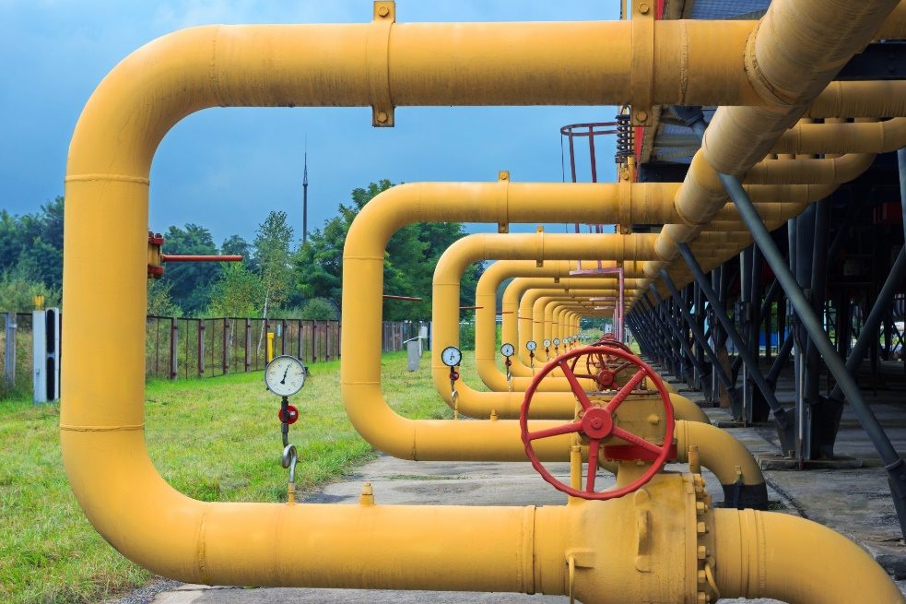
Networking
Addresses and DNS
Ports
TCP
UDP

Slide 2
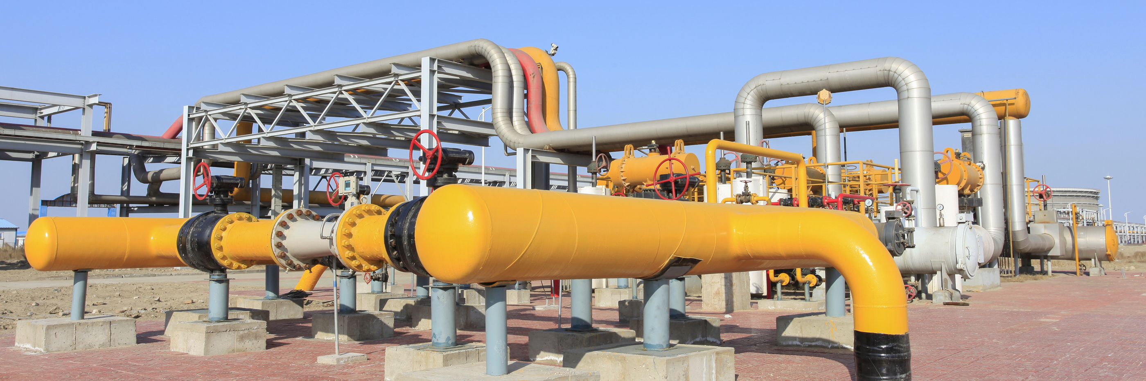
See Also
https://docs.oracle.com/javase/tutorial/networking/overview/networking.html

Slide 3
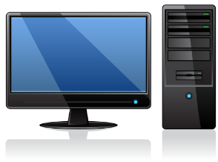

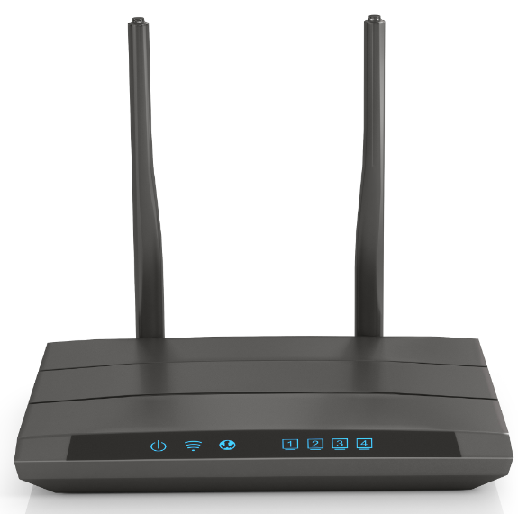
Ethernet
10.2.14.5
DNS
Domain | Address
google.com | 74.125.196.139
amazon.com | 54.239.17.6
uah.edu | 146.229.1.10
1.9.2.1
10.2.14.14
10.2.14.1
1.9.2.5
10.2.14.8
14.2.2.7
14.2.2.16
1.9.2.8
Each machine has a unique address
Routers have multiple connections to bridge networks
DNS maintains a map between name and number
Streams of bytes … two ways (into your program and out of your program)
Disks, consoles, sockets, keyboards, printers
Know how to talk streams and you can talk to anything
Initialization (constructor) is different. Use is the same.

Slide 4
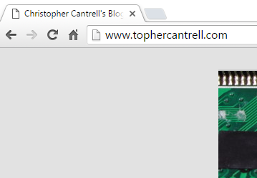
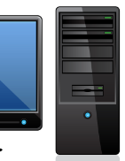
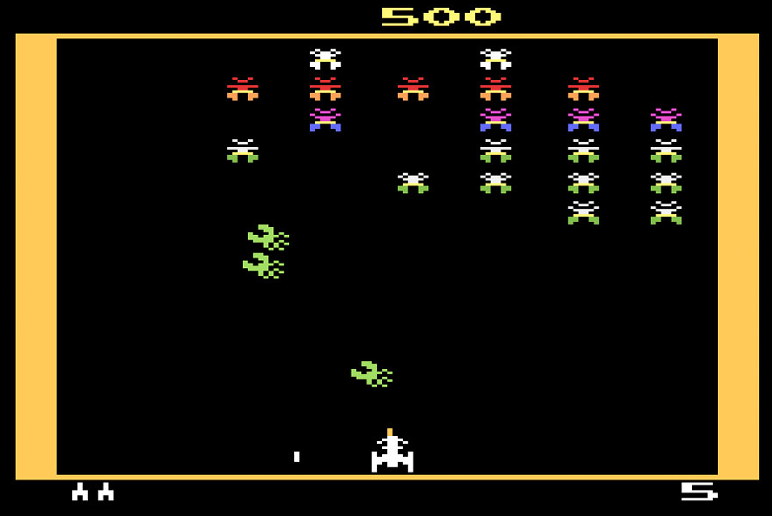
Ports
10.2.14.2
10.2.14.5
Web Server
80
FTP
21
75.75.8.43
Blaster Man
15583
Streams of bytes … two ways (into your program and out of your program)
Disks, consoles, sockets, keyboards, printers
Know how to talk streams and you can talk to anything
Initialization (constructor) is different. Use is the same.

Slide 5
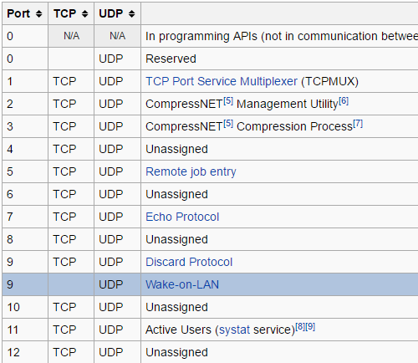
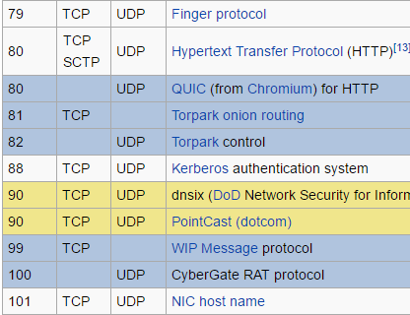
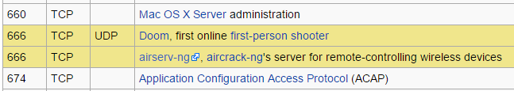
Well-Known and Registered Ports
0 – 1023: Well known ports
1024 – 49151: Assigned by IANA
49152 – 65535: Dynamic, Private, or Ephemeral
11111111
11111111
2¹⁶ = 65,536
https://en.wikipedia.org/wiki/List_of_TCP_and_UDP_port_numbers
Streams of bytes … two ways (into your program and out of your program)
Disks, consoles, sockets, keyboards, printers
Know how to talk streams and you can talk to anything
Initialization (constructor) is different. Use is the same.

Slide 6

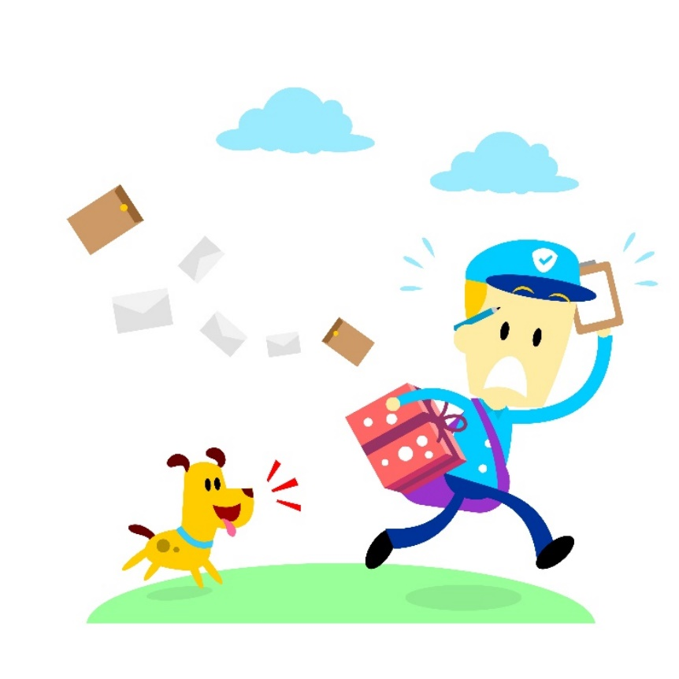
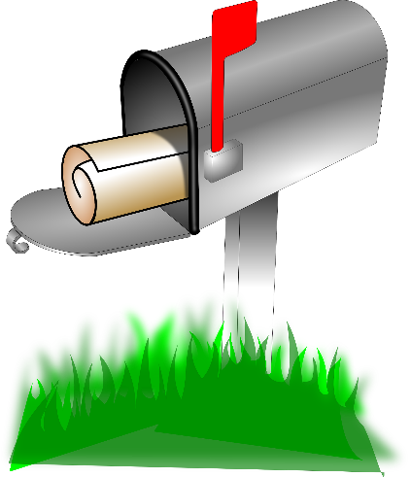

User Datagram Protocol (UDP)
From: 10.2.14.5:502
To: 192.168.1.10:28
To: 192.168.1.10:28
Data Bytes
10.2.14.5:502
192.168.1.10:28
Streams of bytes … two ways (into your program and out of your program)
Disks, consoles, sockets, keyboards, printers
Know how to talk streams and you can talk to anything
Initialization (constructor) is different. Use is the same.

Slide 7
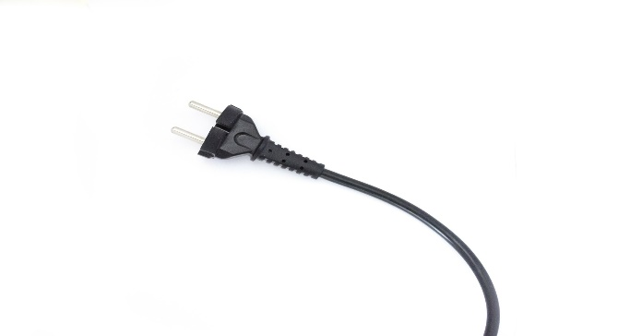
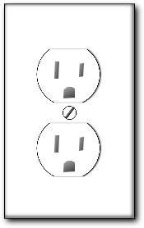
Transmission Control Protocol (TCP)
10.2.14.5:502
192.168.1.10:28
OutputStream
OutputStream
10
B4
22
18
19
4F
19
4F
10
B4
22
18
InputStream
InputStream
Connector
Listener
Streams of bytes … two ways (into your program and out of your program)
Disks, consoles, sockets, keyboards, printers
Know how to talk streams and you can talk to anything
Initialization (constructor) is different. Use is the same.
Notes:
Either side can terminate
Once connected they are the same
Listener <- Connector

Slide 8
UDP vs TCP
 | UDP | TCP
Speed | Fast | Slow
Reliability | Unsure | Guaranteed
Ordering | Unsure | Guaranteed
TCP: Web browsing, email
UDP: Streaming media, games
Streams of bytes … two ways (into your program and out of your program)
Disks, consoles, sockets, keyboards, printers
Know how to talk streams and you can talk to anything
Initialization (constructor) is different. Use is the same.

Slide 9

Tinkering
Open a command prompt in your virtual machine and enter the following commands:
“ipconfig /all”
“tracert google.com”
What information are these commands giving?
How does compare to the same commands running on your personal computer?
Notes:
Reference the discussion area

